Slide 1
Building and Deploying Safe and Secure Android Apps for Enterprise
Presented by
Technology Consulting Group
at Endeavour Software Technologies

Slide 2
Session Contents
Overview of Mobility and Mobile Security
Introduction to Mobility
Mobile Security
Best Practices for Secure Software Development
Android OS
Security Architecture and deployment
Android Attack Surfaces
Enterprise features, What can we leverage?
Questions?
2

Slide 3
Mobility
A Capability
Communicate and Access
On the Move
Anytime
From Anywhere
Voice, Messages, Data
Enterprise Mobility
The ability of an enterprise to connect to people and control assets from any location.
Technologies that support enterprise mobility include wireless networks, mobile applications, middleware, devices, and security and management software.
Forrester Research Definition
3

Slide 4
What is happening in the Corporate World?
Mobility In the Enterprise
Content
Transactions & Workflow
Analytics & Reporting
Telecom Expense Management
Customer Outreach
Extension of Enterprise Data
Corporate Communications
4
Notes:
There is a realization that mobility goes beyond email. Isolated success in deployment of mobile solutions have reinforces this belief.
The main application areas:
Using mobility to extend the reach and availability of corporate data. Allowing for better informed decision making
Enabling corporate communications
Email
Instant Messaging
Social Media Tools
3. Using the mobile device as an application and service delivery platform
1. Content: access and presentation of corporate content on a device, providing the right information at the right time and place
2. Transactions and Workflows: Enabling a mobile worker to work away from office
3. Analytics and Reporting: Dashboards with intelligent reporting and analytic capabilities provide powerful business aides on the move.
4. A derivative of mobile deployment: COST -> From device procurement, software overheads, recurring telecom expenditure. Telecom expense management: Cost control and management
5. Customer outreach: using the reach of mobile devices to reach, communicate with, track behaviour, provide service, generate brand recall, and loyalty, using the power social media on mobile devices

Slide 5
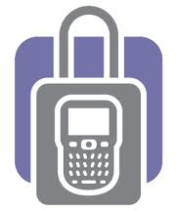
Mobile Security – Everywhere!
Device Level
Network Level
Application Level
5

Slide 6
Mobile Security Considerations
Mobility Infrastructure
Security is a key focus area.
Ensuring existing policies is implemented
Integration with existing tools, systems
Keep devices light, manageable
Mobile Middleware Platform
Composite Applications Landscape and devices
Mobile Device Management
Mobile Data Synchronization
Phased approach for Common Services and Mobile Applications
Mobile Applications Distribution
Enterprise distribution through OTA to specific devices
Infrastructure
Middleware
Application
6
Notes:
Mobility Infrastructure
Security is a key focus area. Ensuring existing policies is implemented for Mobility
Integration
Extend existing integration tools and rules
Integration with the existing backend system
Can we “Build everything as an infrastructure component and keep devices light”?
Definite need for Mobile Middleware Platform
Composite Applications Landscape, Composite Devices to be supported
Mobile Device Management is an urgent Priority! Start managing your devices from Day 1!
Common Services and Mobile Applications Layer can arrive in stages
Mobile Applications Distribution
Enterprise distribution through OTA to specific devices
http://www.cellcrypt.com/deployment

Slide 7
Application Security – Must Include
User Authentication
Data Security on Device
Data in Transit Issue
Device Management and Application Provisioning
7
Notes:
1. User Authentication:Due to the size limits of mobile devices, mobile applications tend to neglect password policies of enterprise. The
desktop application may be following 8-10 character password policy but mobile application may be allowing 4 characters PIN. One should
carefully evaluate the effect of such diversions from norms and come up with a pragmatic approach keeping mobile device size and
security in perspective.
2. Data Security on Device: Mobile applications tend to store data on local device for performance reasons. This can pose serious
risks. One can think about encrypting the data for local storage but then encryption-decryption is a resource intensive function especially
if you rely on asymmetric algorithms. One should take a balanced approach, for example one can use symmetric algorithms for
encrypting data and use asymmetric key for encrypting symmetric key.
3. Data in Transit Issues: Data in transit (when data moves from one system to another system) is another critical aspect of data
security. In the case of mobile applications, there are so many intermediaries in-between. Ensuring the data confidentiality and data
integrity in transit can pose serious challenges.
4. Device Management and Application Provisioning: As one can imagine, people move to different departments within the same
company. With the move, it is critical that their access to enterprise applications via mobile applications is provisioned and de-provisioned
in a controlled manner. Managing the right level of mapping between mobile devices and mobile applications poses unauthorized access
risk.
5. Security Analysis and Monitoring:Monitoring security incidents such as password changes, failed logons, unauthorized access
requests, non-repudiations is critical as they can help you identify risks in your mobile application environment. A carefully structured
approach towards mobile applications security monitoring can help you to thwart these risks.

Slide 8
Mobile Security Considerations
Access
Credentials
IMEI/ 2FA
Storage
Files
Key Storage
Transportation
Session
OTP, User – Agent
Quick Access Code, Token
Resources
Protocols
Connection Points
8

Slide 9
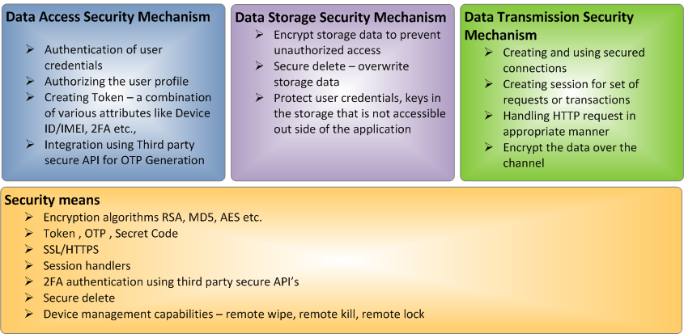
Enterprise Mobile Security – Do’s
9

Slide 10
Enterprise Mobile Security – Best Practices
Protect the Brand Your Customers Trust
Know Your Business and Support it with Secure Solutions
Understand the Technology of the Software
Ensure Compliance to Governance, Regulations, and Privacy
Know the Basic Tenets of Software Security
Ensure the Protection of Sensitive Information
Design, Develop and Deploy Software with Secure Features
10

Slide 11
Android Security Architecture
Permission Based Model
Remote App Management
Sandbox
11

Slide 12
Android Security – Permission based model
Permission-based Model
Linux + Android’s Permission
Well defined at system level
Approved by user at install
High-level permissions restricted by Android runtime framework
For example, an application that needs to monitor incoming SMS messages would specify
<manifest xmlns:android="http://schemas.android.com/apk/res/android" package="com.android.app.myapp" > <uses-permission android:name="android.permission.RECEIVE_SMS" /> ... </manifest>
12
Notes:
A particular permission may be enforced at a number of places during your program's operation:
At the time of a call into the system, to prevent an application from executing certain functions.
When starting an activity, to prevent applications from launching activities of other applications.
Both sending and receiving broadcasts, to control who can receive your broadcast or who can send a broadcast to you.
When accessing and operating on a content provider.
Binding to or starting a service.

Slide 13
Android Security – Remote App Management
Remote Install/removal
Google can remove or install apps remotely
Users can install apps remotely from online Android Market
http://market.android.com
13

Slide 14
Android Security - Sandbox
14
Notes:
Application Isolation – Note editor cannot read email
Distinct UIDs and GIDs for each install

Slide 15
Android’s Attack Surfaces
Isolated applications is like having multi-user system
Single UI/ Device ➔ Secure sharing of UI and IO
Principal maps to code, not user (like browsers)
Appeals to user for all security decisions
Phishing style attach risks
Linux, not Java, Sandbox. Native code not a barrier
Any java App can execute shell, load JNI libraries, write and exec programs
Reference – iSEC PARTNERS
15

Slide 16
Enterprise features (Froyo/ GingerBread)
Remote wipe
Remotely reset the device to factory defaults
Improved security
Addition of numeric pin, alphanumeric passwords to unlock the device
Exchange calendars
Auto-discovery
Global Address List
C2DM* – Cloud to device messaging
*Still it is part of Google Code Labs
16
Notes:
Android Cloud to Device Messaging (C2DM) is a service that helps developers send data from servers to their applications on Android devices. The service provides a simple, lightweight mechanism that servers can use to tell mobile applications to contact the server directly, to fetch updated application or user data. The C2DM service handles all aspects of queueing of messages and delivery to the target application running on the target device.

Slide 17
Enterprise features (Honeycomb)
New device administration policies
Encrypted storage
Password expiration
Password history
Complex characters in password
Configure HTTP proxy for each connected WiFi access point (AOS 3.1 only)
Encrypted storage cards
17

Slide 18
Thanks!
You!
For patiently listening to us!
Silicon India team
Endeavour’s Android TCG team
Happy to receive feedback and questions at tcg@techendeavour.com
18

